Slide 1

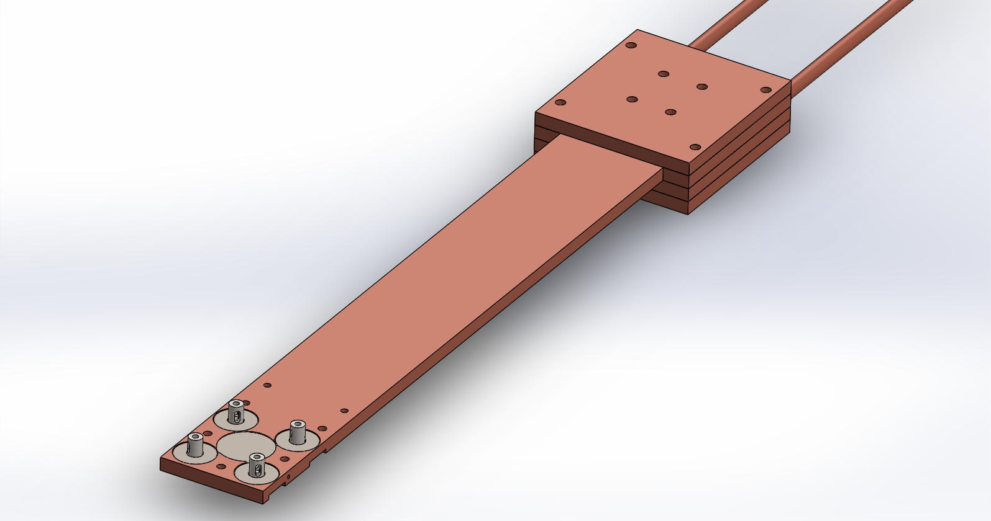
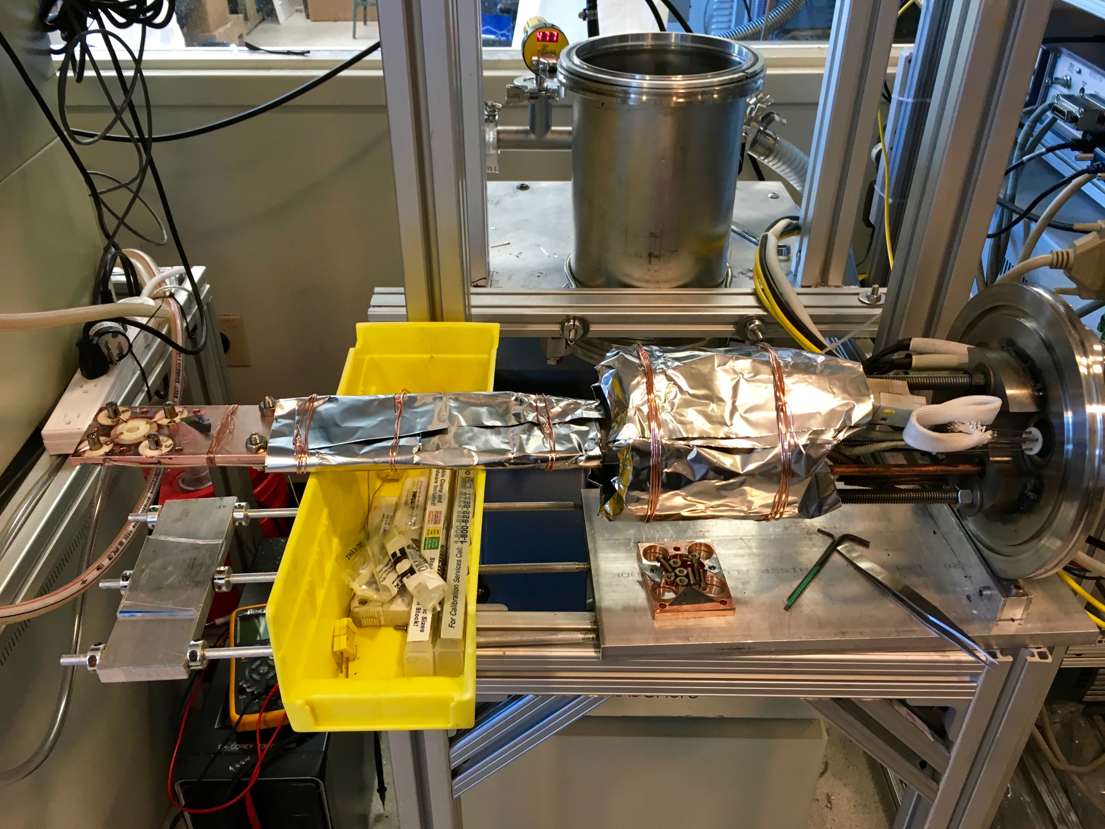
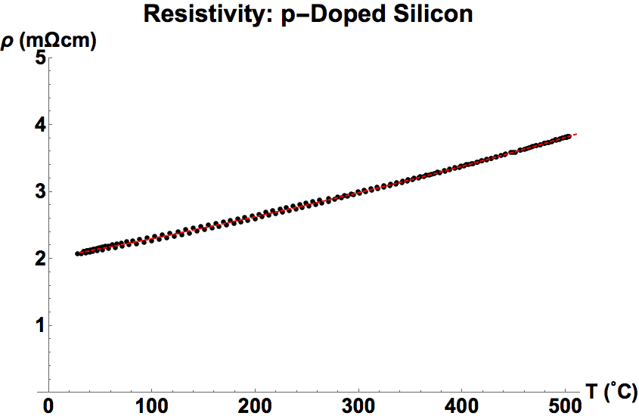
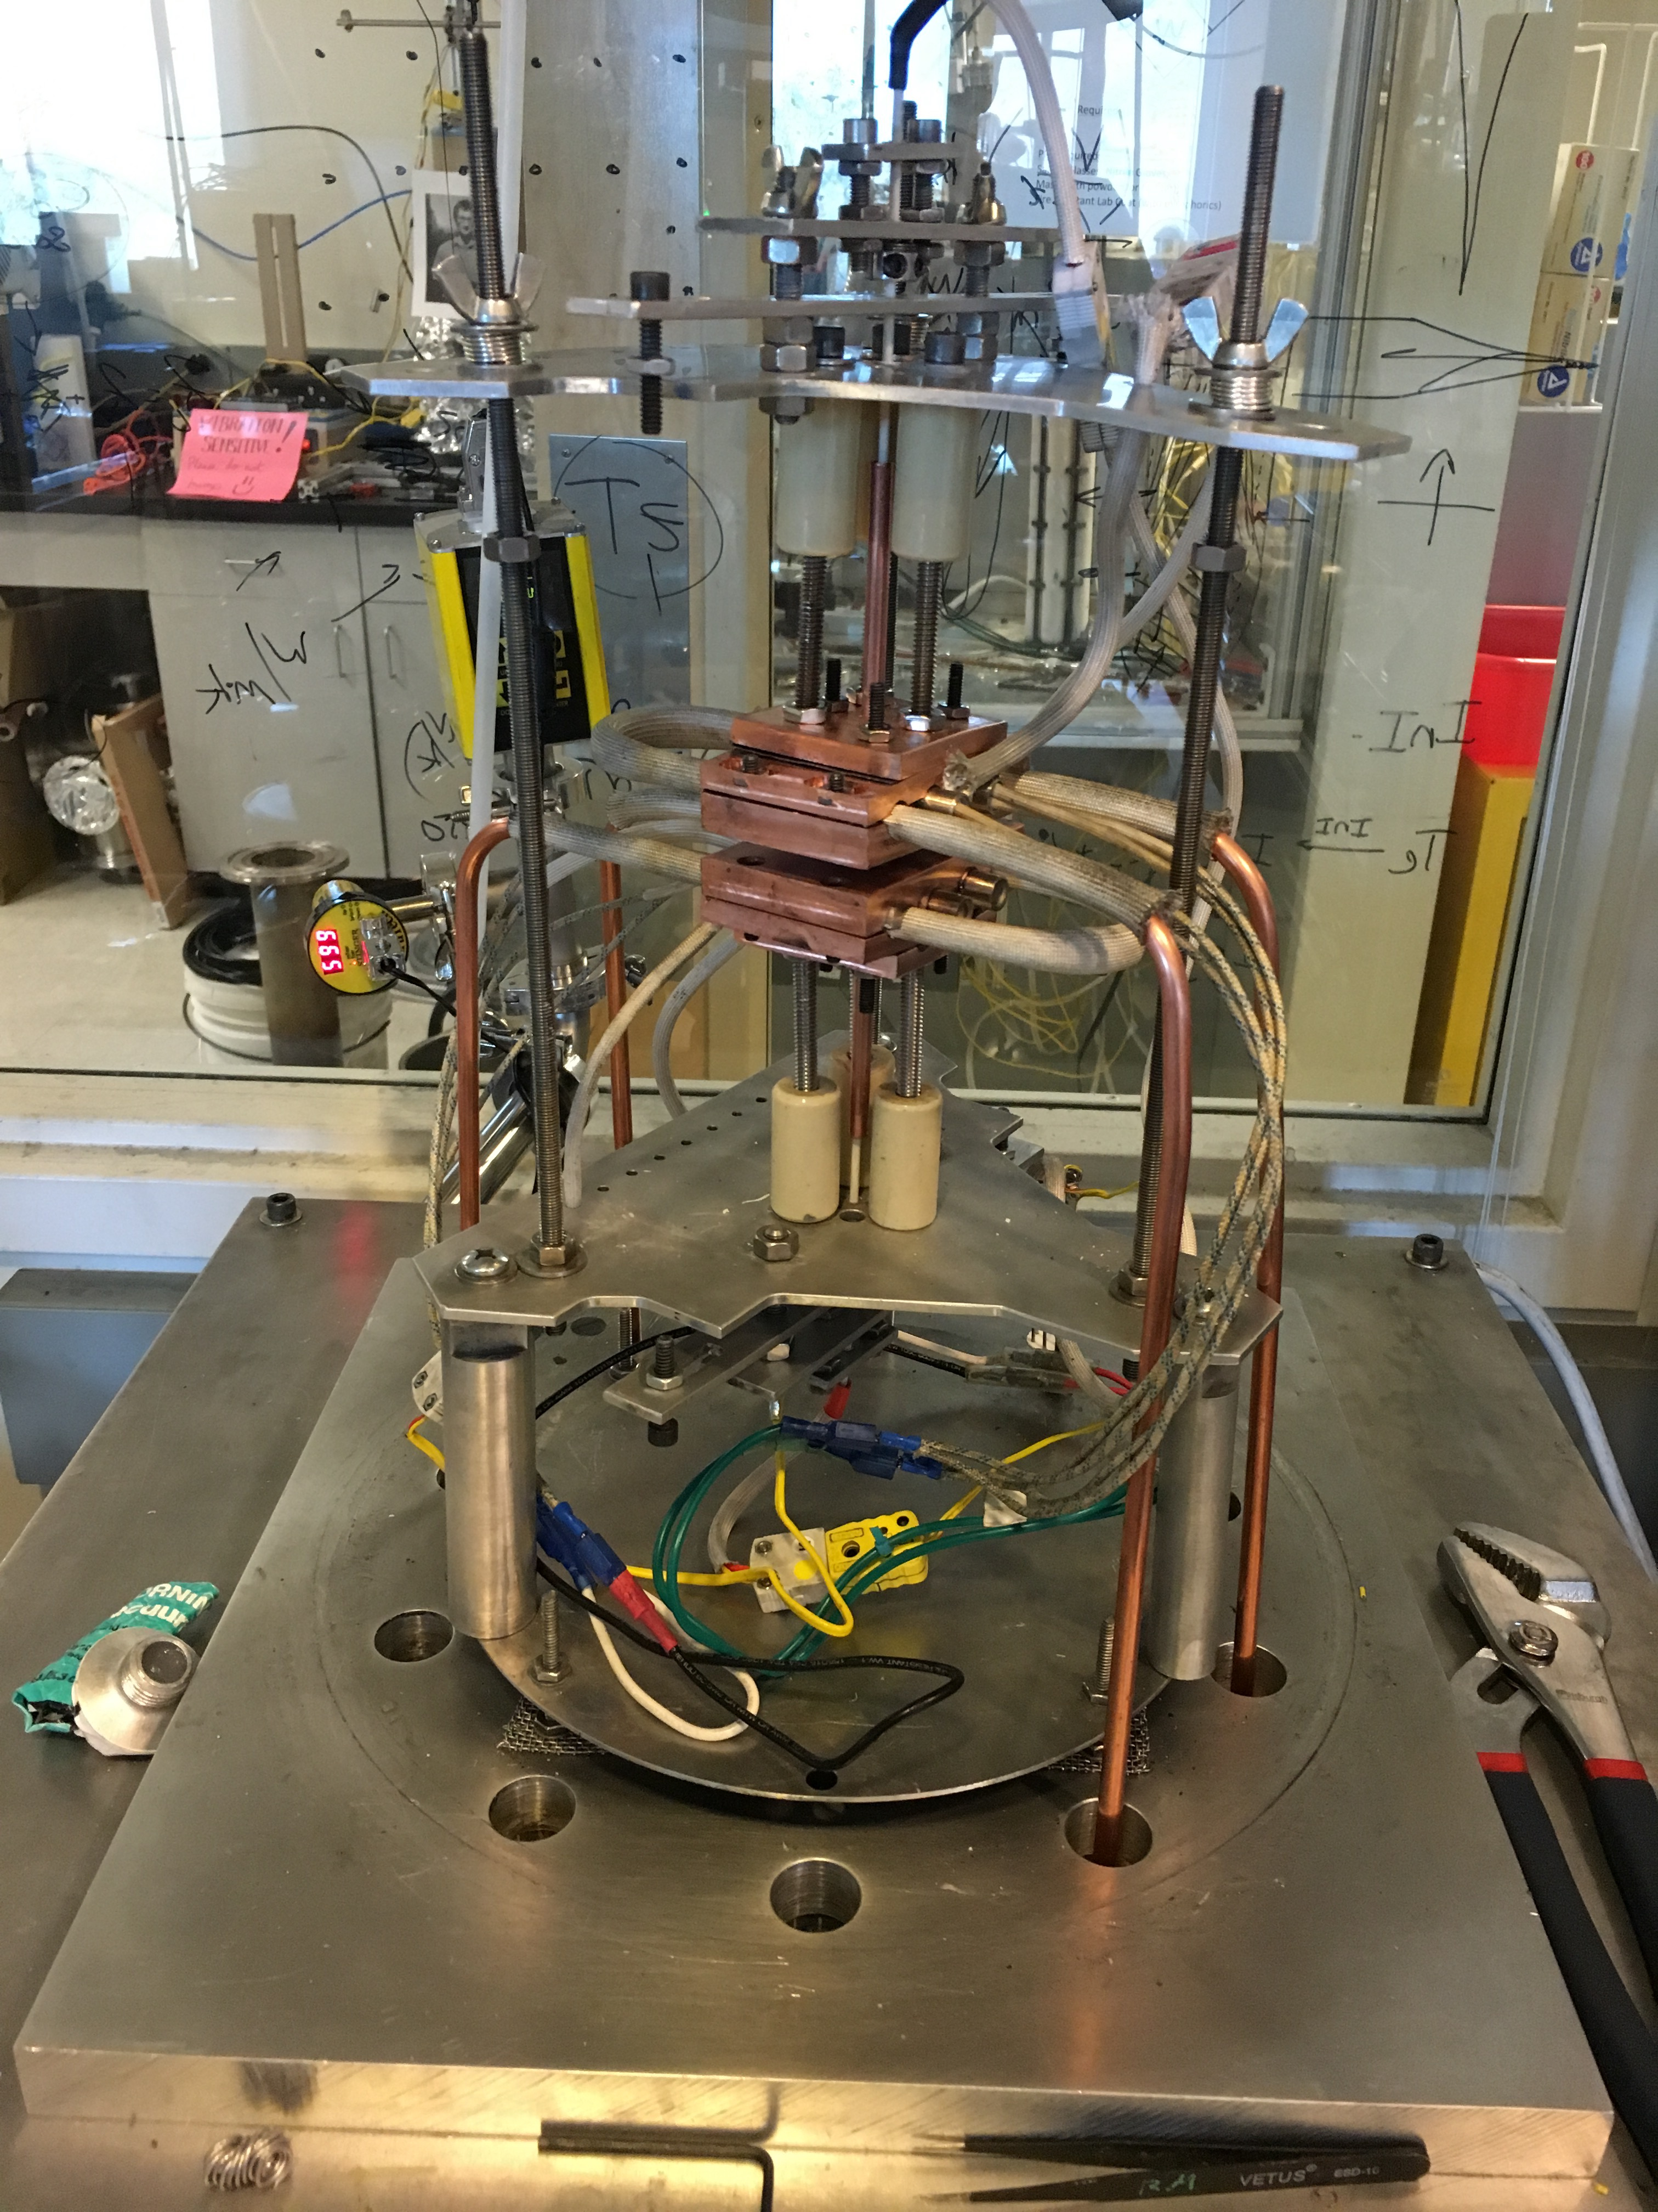
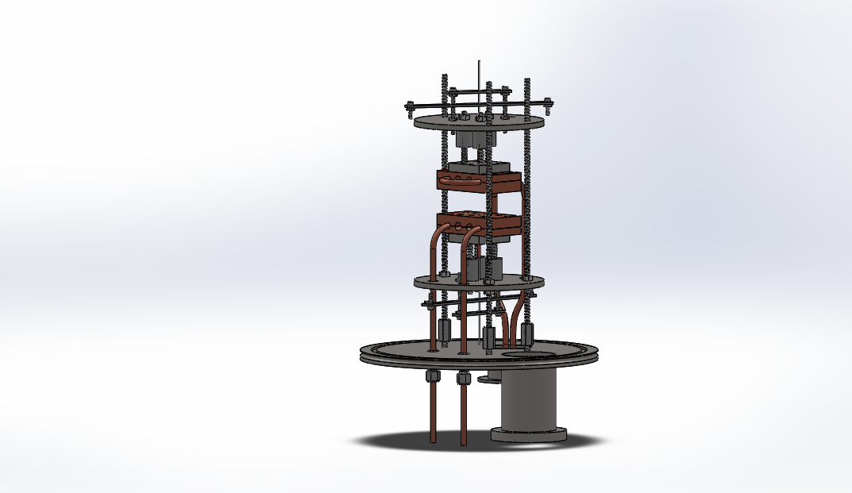
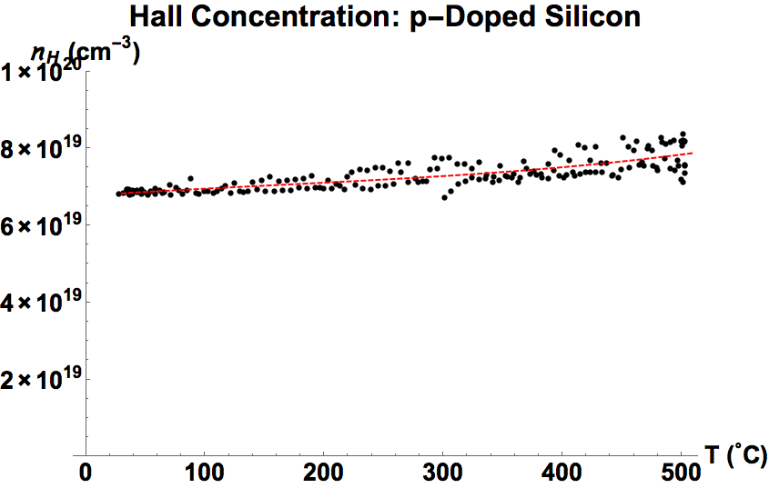
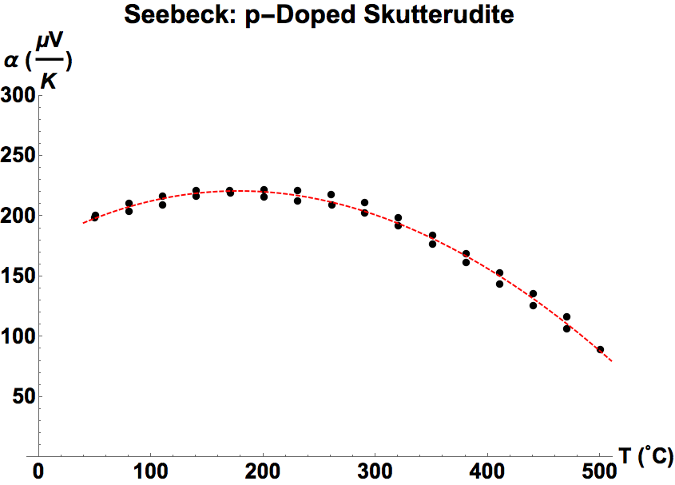
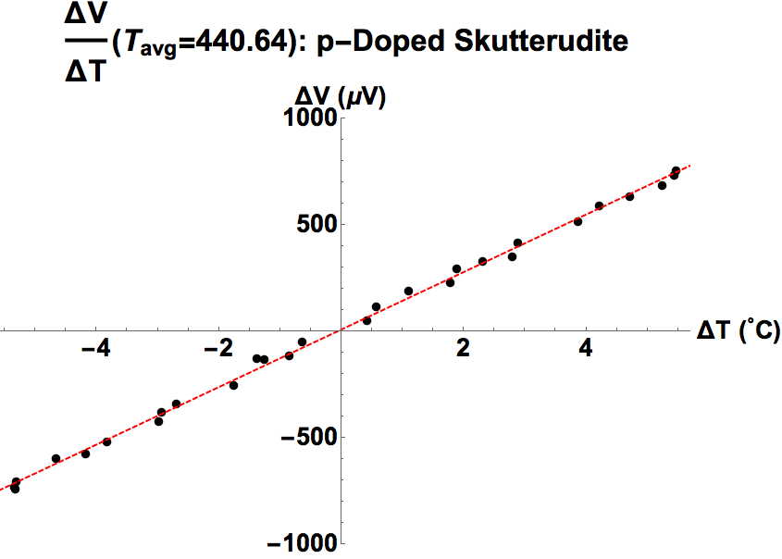
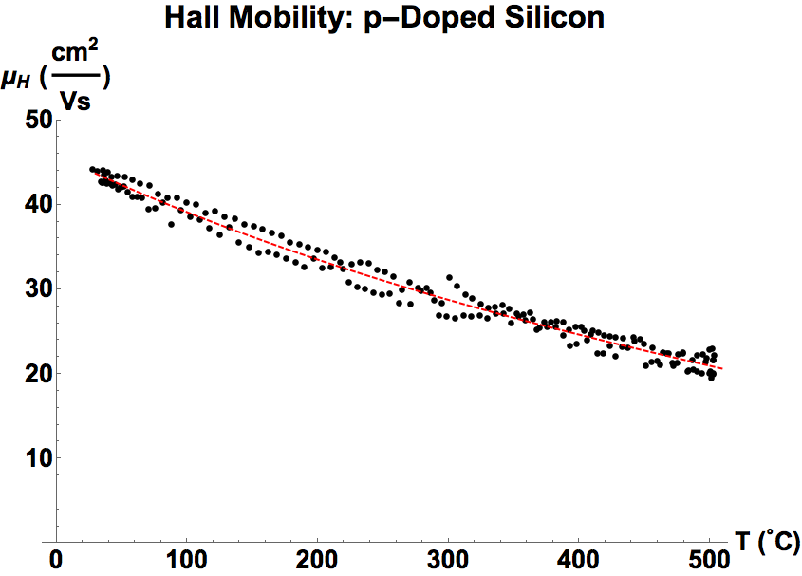





High Throughput, High Temperature Thermoelectric Measurements
Seebeck, Resistivity, and Hall
Robert W. McKinney*⍿, Eric S. Toberer ⍿
⍿Colorado School of Mines, Department of Physics
*rmckinne@mines.edu
Justification
Design Considerations
Systems Implementation
Seebeck and resistivity necessary in order to calculate zT
Carrier Concentration necessary for Pisarenko Plot of α vs. n in order to calculate m* from SPB model
Thermoelectric quality factor depends directly on mobility
Good temperature measurement and control is an absolute necessity
For good thermoelectric materials, we are interested in the range 50-600℃
Heating material must be cost effective and good thermal conductor
Measurement runs should take data on both heating and cooling cycles
For high throughput (~2 samples/day), measurement cycles should be on the order 8 hours
Temperature controlled and measured using Omega CN7500 PID controllers
Voltages and Currents controlled and measured using Keithley 2000 series digital multimeters
Heating elements are cartridge heaters embedded in copper
Lakeshore Electromagnet used for Hall Effect measurement
Measurement automation and data taking scripts written in Python 2.7
$$zT=\frac{α^{2}}{ρ\left(κ_{l}+κ_{e}\right)}$$
$$β∝\frac{μ_{0}N{m^{∗}}^{3/2}}{κ_{l}}$$
Seebeck Effect
Resistivity and Hall Effect
Seebeck measured at discrete temperatures using Quasi-Steady-State method
System is pumped down to 10⁻⁶ Torr using Diffusion Pump
System can reach steady temperature of 600℃ safely
Each side of sample heated independently using cartridge heaters embedded in copper blocks
Good thermal contact maintained by using discs of graphite foil between sample and heater block as well as springs to uniformly load the sample
System is cooled using compressed air pumped through copper tubing embedded in heater blocks
Sample temperature and voltage are measured using Type K thermocouples in uniaxial configuration
Minimal hysteresis found over heating and cooling cycles
Heater block assembly
Van der Pauw Measurement Stage & Sample Holder
Resistivity and Hall Coefficient measured continuously during temperature cycle using Van der Pauw method
System is pumped down to 10⁻⁵ Torr using Diffusion Pump
Heat applied at the top of the apparatus to avoid heating in magnetic field
System can reach steady temperature of 500℃ at the sample
System is cooled using compressed air pumped through copper tubing embedded in heater block at the top
Temperature ramp rate typically maintained around 1 ℃/min for 8-9 hour cycle
Minimal hysteresis found over heating and cooling cycles
Upper heater block assembly
Measurement thermocouple
Sample stage
Lower heater block assembly
Acknowledgements
References
Special thanks to Kasper Borup (NREL), whose system designs were the basis of these and who has been an invaluable resource. Thanks to Corey Hardin (SLAC), who also served as a technical advisor on many aspects of these builds. Thank you to David Ademe (CSM), who created the Solidworks assembly for the Seebeck system. Brenden Ortiz (CSM) has also been very helpful with debugging the systems. Funding provided primarily by JPL and NSF.
K. A. Borup, et al., Energy Environ. Sci., vol. 8, no. 2, pp. 423–435, Feb. 2015.
J. Martin, T. Tritt, and C. Uher, J. Appl. Phys., vol. 108, no. 12, p. 121101, Jan. 2010.
G. J. Snyder and E. S. Toberer, Nat. Mater., vol. 7, no. 2, pp. 105–114, Feb. 2008.

